Slide 1
RESTARUENT CHAT BOT
CAPSTONE PROJECT
Presented By:
1. CHOKKAPU SAI GANESH –MALLA REDDY INSTITUTE OF TECHNOLOGY & SCIENCE -ECE

Slide 2
OUTLINE
Problem Statement (Should not include solution)
Proposed System/Solution
System Development Approach (Technology Used)
Result
Conclusion
Future Scope
References

Slide 3
Problem Statement
Create a restaurant chatbot which help the customer to find the food item in the restaurant and assist in ordering food and answering menu and related questions and it shows the verity types food in that restaurant like it give the option in vegetarian and non-vegetarian which help to find easy

Slide 4
Proposed Solution
User Interaction: The chatbot engages users in natural language conversations, using prompts and responses to guide them through the ordering .
Information Collection: It prompts users to input their name, breakfast, lunch or dinner and vegetarian and non vegetarian.
Query Handling: The chatbot responds to inquiries about the food item in vegetarian and non vegetarian and helpful responses.
User Guidance: It provides step-by-step guidance, and select the required food item in that and help to order their food items .
Feedback Mechanism: The chatbot incorporates a feedback mechanism to improve its responses and user experience over time, ensuring continuous optimization.

Slide 5
System Approach
The "System Approach" section outlines the overall strategy and methodology for developing and implementing Here's a suggested structure for this section:
System requirements : windows 11 operating system , 8GB RAM, I3 Processor
Library required to build the model : IBM Watson x assistant

Slide 6
Result
a Restaurant chat bot designed to provide a information about the food items in that restaurant and it helps to order the food for the customer. It’s main goal is to save the time of the customer and helps the restaurant to get more number of order and helps the order error which are manually ordered and helps the restaurant for limited personalization Additionally, a feedback mechanism ensures ongoing improvement of the chatbot's performance and user experience.

Slide 7
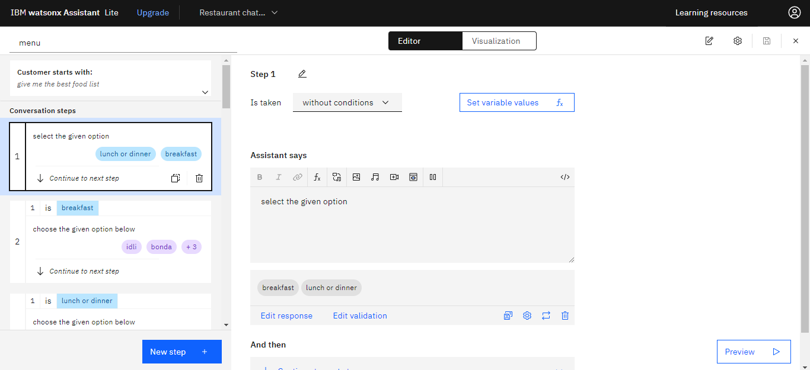
Result

Slide 8
Project Link(GitHub, Google drive link)
https://github.com/chokkapu-sai/Restaurant-bot

Slide 9
Conclusion
In conclusion, the development of a Restaurant chat bot offers a practical solution to enhance the application experience for Restaurants . By leveraging natural language processing and , the chatbot effectively guides users through the ordering process while providing timely and accurate information. With its user-friendly interface and feedback mechanism, the chatbot ensures continuous improvement and optimization, ultimately contributing to a seamless and efficient ordering process for both Customer and the Restaurants .

Slide 10
Future scope
Seamless ordering and payment : Integrate with mobile payment systems and enable customers to order and pay directly through the chat bot..
Real-time menu updates and recommendations : Use machine learning to suggest menu items based on customer preferences, seasonality, and ingredient availability.
Conversational commerce : Enable customers to order and pay directly through conversational interfaces like voice assistants or messaging platforms..
Partnerships and integrations : Collaborate with food delivery services, meal kit providers, or nutrition apps to expand the chat bot's reach.

Slide 11
References
IBM watsonx Assistant tutorial

Slide 12
course certificate 1

Slide 13
course certificate 2

Slide 14
THANK YOU

